Slide 1

THE RURAL EDUCATION & TECHNOLOGY INITIATIVE of
AMERICA

Slide 2
PURPOSE
Develop technology infrastructure systems in US Rural School Districts to access the following:
Quality K-12 academic programs: STEM, computer/tech training to prepare for college and 21st century careers;
Effective teachers and administrators;
Apprenticeships, Mentors, Tutors;
Research and Data for School Improvement;
Online Professional Development for Teachers, Education Leaders, Parents and Stakeholders.

Slide 3
BACKGROUND
More than, 3,700 K-12 schools in the U.S, 79% located in rural and small towns, lack access to the fiber networks needed to access broadband enabled digital learning opportunities.
E-rate programs with affordable internet support to schools must be expanded.
Nationally renowned companies overlook rural areas due to a workforce that does not have expertise required by our information and knowledge economy.

Slide 4
RURAL PUBLIC SCHOOL ENROLLMENT
47 million adults and 13.4 million children under the age of 18 lived in counties outside of America's major metropolitan regions.
Fewer than 1 in 5 or 19.5% in rural communities earned a bachelor's degree as opposed to 29% of America’s urban dwellers.

Slide 5
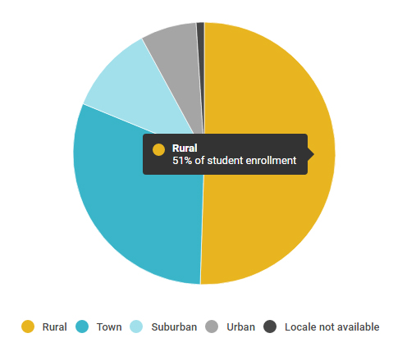
RURAL vs URBAN EDUCATION ENROLLMENT

Slide 6
TECHNOLOGY ACCESS
Rural districts lack access to reliable broadband internet access which increases difficulty for districts, schools and students to
Apply for grants,
Provide consistent quality classroom instruction,
Administer quality educational programs,
Conduct student research,
Offer meaningful and productive career options,
Access apprenticeship and mentoring opportunities,
Attract, train, and retain teachers and principals in communities with fewer amenities and activities than urban and suburban areas,
Offer advanced courses or training that better prepare students for college and relevant 21st century careers.

Slide 7
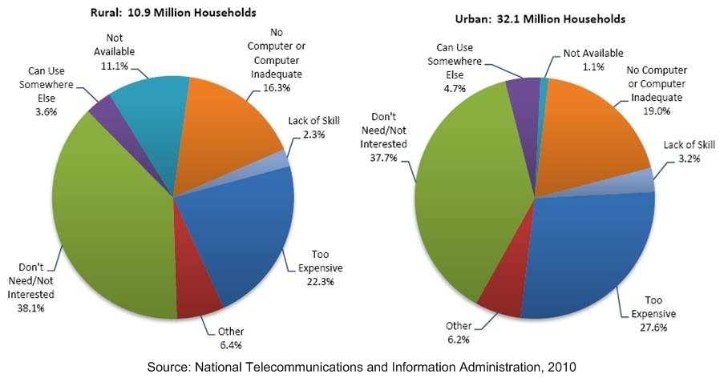
RURAL vs URBAN TECHNOLOGY ACCESS

Slide 8
INCOME DISTRIBUTION
EMPLOYMENT
Rural employment is skewed toward goods production,
20% or more work in manufacturing or construction fields.
1/5 or more rural employees work in educational services, health care and social assistance positions.
12.1 percent work in manufacturing.
Urbanites earn $54,300 median household income annually, $2,000 more than their rural counterparts.
Source: Census Bureau 2015

Slide 9
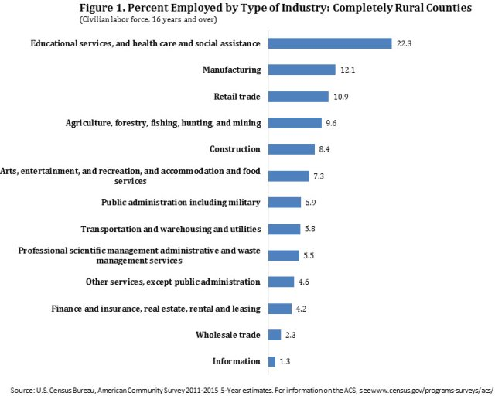
RURAL EMPLOYMENT DISTRUBUTION

Slide 10
SOLUTIONS
Develop and implement Rural Technology infrastructure plans and strategies that ensure rural students have access to proven academic programs which match current 21st c. workforce demands through easy to use, reliable and stable technology systems.
Secure funding and expertise from multiple public and private sources to develop technology infrastructure systems in 50 state rural areas’ to connect school districts and students to effective online academic programs.
Build awareness and demand by coordinating a Rural Education Initiative of America effort among various diverse constituencies at the state, district and local community level targeting the key decision-makers at each level.
Design and execute an effective communication marketing strategy, including social media that highlights the need for the Rural Education Initiative of America within and among diverse communities. Communicate need, plan and progress.
Designate one or more spokespersons (notables) to articulate Initiative message. ‘Bring Innovative Jobs to America’s Heartland’ by offering Quality, Accessible, Practical Education in Rural America, Prepare Students for 21st C Careers.
Connect the plan to the funds to the decision-makers to the programs and students.

Slide 11
THE TODAY FOUNDATION
CONTACT for INFORMATION

